Slide 1
Driving the 28BYJ-48 Stepper motor and ULN2003 Board with an Arudino
Bret Stateham
Microsoft Technical Evangelist
BretStateham.com
@BretStateham

Slide 2
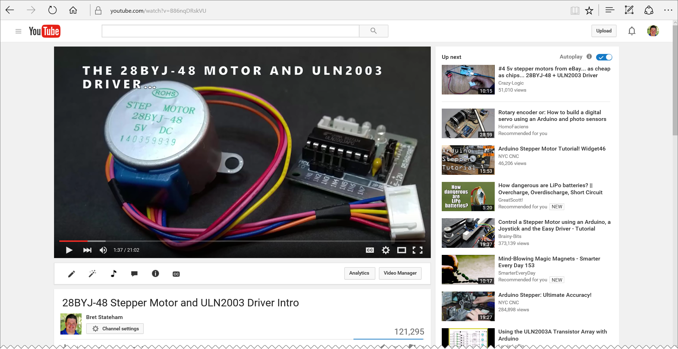
Overview video
http://aka.ms/28byj

Slide 3
HOOKING IT ALL UP
Connect IN1-IN4 on the ULN2003 board to Digital Output pins 2-5 Respectively on your Arduino.
Use a separate power source for the motor. Just do it.
2
3
4
5

Slide 4
DRIVING THE MOTOR
Connect IN1-IN4 on the ULN2003 board to Digital Output pins 2-5 Respectively on your Arduino.
Use a separate power source for the motor. Just do it.
2
3
4
5

Slide 5
Stepping methods
STEPS
METHODS
PHASES
1
2
3
4
5
6
7
8
WAVE DRIVE One phase at a time Simplest, but least used
BLUE
PINK
YELLOW
ORANGE
FULL STEP Two phases at a time Strongest Torque
BLUE
PINK
YELLOW
ORANGE
HALF STEP One, or two phases at a time
Smallest step angle Medium torque
BLUE
PINK
YELLOW
ORANGE

Slide 6
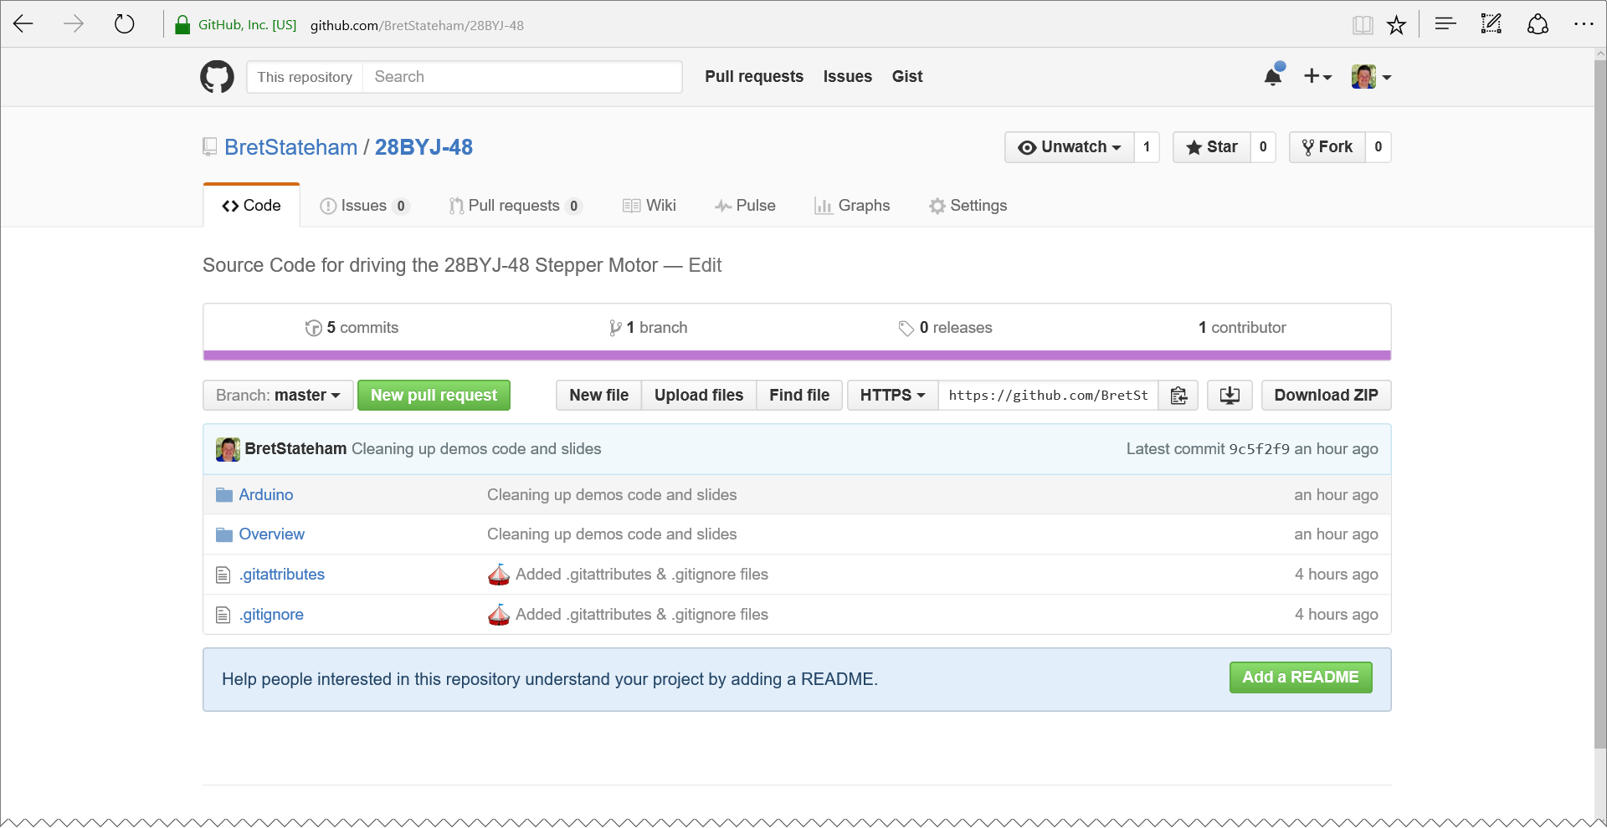
grab the code
You can grab all my code and the slides from my GitHub repo…
http://aka.ms/28byjrepo

Slide 7
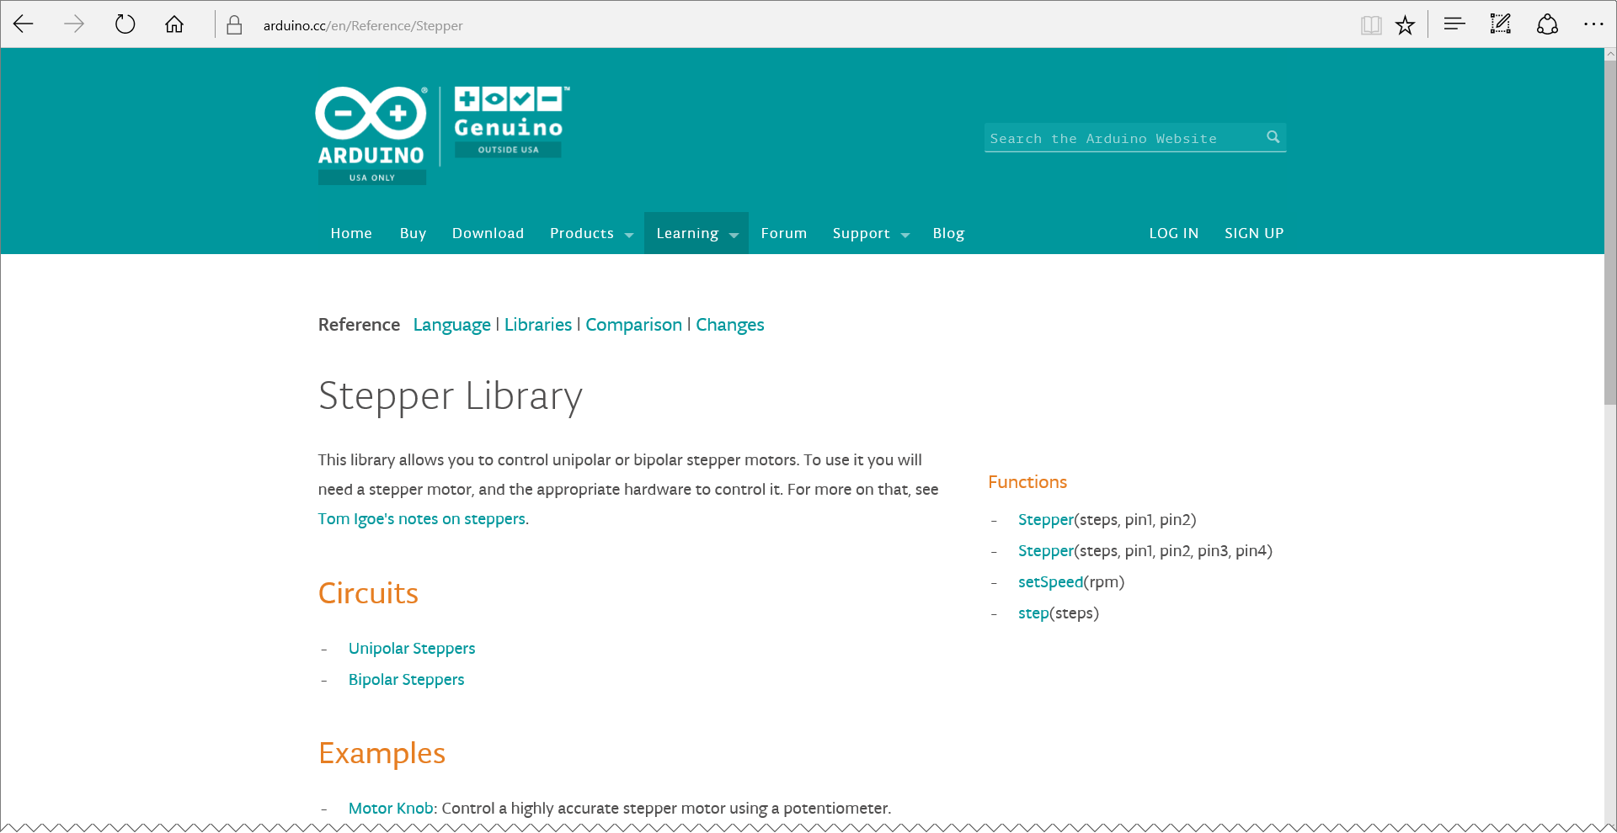
ArDuino Stepper Library
Yeah, it’s there,
Nah, it’s not great.
You CAN make it work with the 28BYJ-48, but it only supports Full Stepping, and it lacks other features
https://www.arduino.cc/en/Reference/Stepper

Slide 8
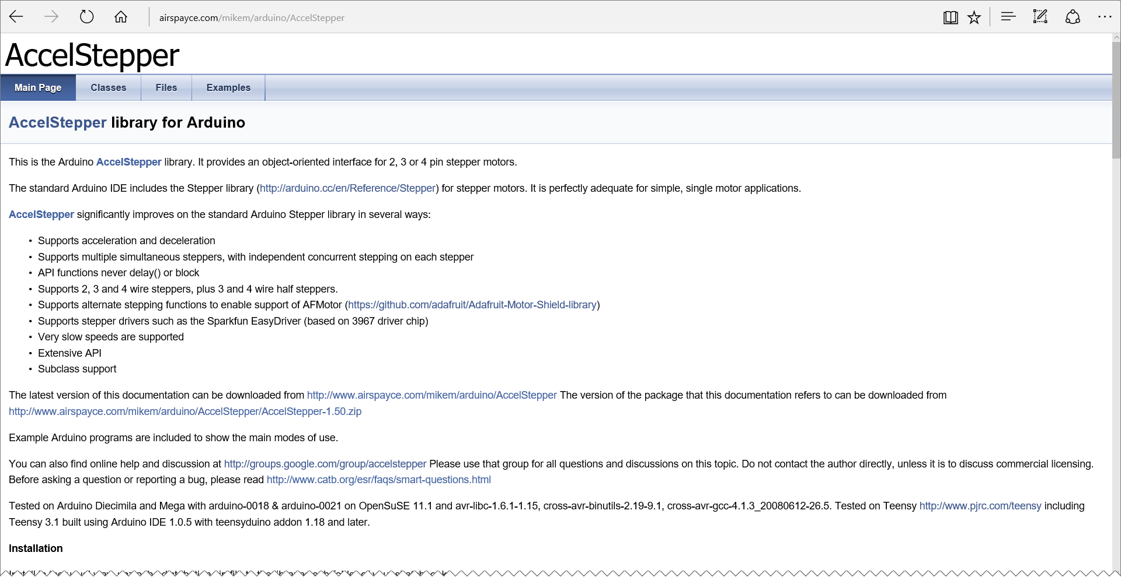
AccelStepper Library
Yeah, it’s there,
Nah, it’s not great.
You CAN make it work with the 28BYJ-48, but it only supports Full Stepping, and it lacks other features
http://aka.ms/AccelStepper

